Slide 1
CONNECTING U.S BUSINESSES TO AFRICA
Presented By : Rodney Brown
Page 01

Slide 2
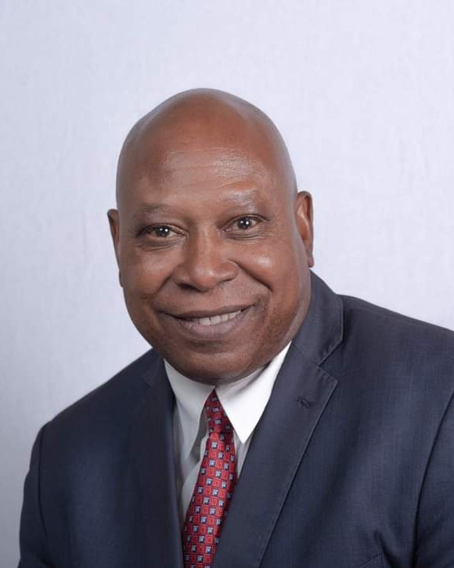
RODNEY BROWN/ CEO
www.newlifeglobaldevelopment.net
Born and raised in Chicago
Over 25 years in Real Estate Development and Asset Management
Developed over $ 200 million dollars portfolios for companies throughout the U.S Successfully completed over 26 major development projects nationwide.
newlifeglobaldevelopment
Page 02

Slide 3
WHO WE ARE
www.newlifeglobaldevelopment.net
newlifeglobaldevelopment
WE ARE AN ECONOMIC DEVELOPMENT
COMPANY BASED IN LOS ANGELES WITH
OFFICES IN CALIFORNIA AND IN TANZANIA THAT FACILIATES IMPORT/ EXPORT AND
REAL ESTATE DEVELOPEMNT
OPPORTUNITIES BETWEEN THE U. S AND AFRICAN BUSINESSES.
Page 03

Slide 4
OPPORTUNITIES
www.newlifeglobaldevelopment.net
newlifeglobaldevelopment
PROSPER AFRICA INITIATIVE
AFRICAN INVESTORS
BLACK OWNED
BANKS
Page 04

Slide 5
PROSPER AFRICA INITIATIVE
www.newlifeglobaldevelopment.net
Goal is to increase trade and investments between African nations and the U.S
Offers U.S government resources that will aid in
the advancement within key sectors such as, clean energy, healthcare, digital technology and mining
3. Create jobs for African and American workers and drive billions of dollars into the African markets
Page 05
newlifeglobaldevelopment

Slide 6
AFRICAN INVESTORS
www.newlifeglobaldevelopment.com
WHY INVEST?
Provides the opportunity for African
investors to acquire real estate in the U.S and create Land Trusts.
Favorable debt terms, low-cost acquisitions and positive cash flow.
Page 06

Slide 7
HOW TO INVEST
www.reallygreatsite.com
Through Mergers and acquisitions, Business and Land Trusts.
Take advantage of the L1 Visa to transfer key executives between African businesses and us business.
Page 07

Slide 8
BLACK OWNED BANKS
www.newlifeglobaldevelopment.com
CREATING RELATIONSHIPS
To leverage standby letters of credit (SBLC)
Bank guarantees
Government Bonds and US Treasury
newlifeglobaldevelopment
Page 08

Slide 9
WORKING TOGETHER...
www.newlifeglobaldevelopment.net
Joint Ventures
Collaborations
Partnerships
Page 09

Slide 10
CONTACT US
Send Letter of Interest (LOI) to
Rodney@newlifeglobaldeveolpment.com
Page 10

